Slide 1




Corona Virus Analysis
by Karthik M S

Slide 2

Project Overview: COVID-19 Data Analysis
This project focuses on utilizing data analysis to gain insights into the spread of the Coronavirus. The primary goal is to track trends, identify hotspots, and inform public health strategies. Through temporal and geographical analysis, the project aims to uncover patterns that will guide effective responses, ultimately helping to mitigate the impact of the pandemic.

Slide 3

Dataset:
Province: Geographic subdivision within a country/region.
Country/Region: Geographic entity where data is recorded.
Latitude: North-south position on Earth's surface.
Longitude: East-west position on Earth's surface.
Date: Recorded date of CORONA VIRUS data.
Confirmed: Number of diagnosed CORONA VIRUS cases.
Deaths: Number of CORONA VIRUS related deaths.
Recovered: Number of recovered CORONA VIRUS cases.

Slide 4

Data Collection and Preprocessing
Once collected, the data undergoes thorough preprocessing to ensure accuracy and consistency. This involves cleaning the data to handle missing values, outliers, and inconsistencies.
The data is then transformed and formatted for analysis, ensuring all relevant variables are in a suitable format for analysis.

Slide 5
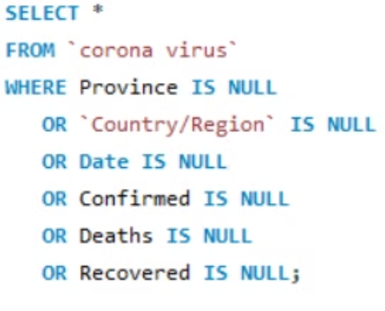
This below query is for the checking for the NULL values
Data Cleaning
Identifying and addressing inconsistencies, missing values, and outliers in the dataset is crucial.
Output: There is no null value present in the dataset

Slide 6
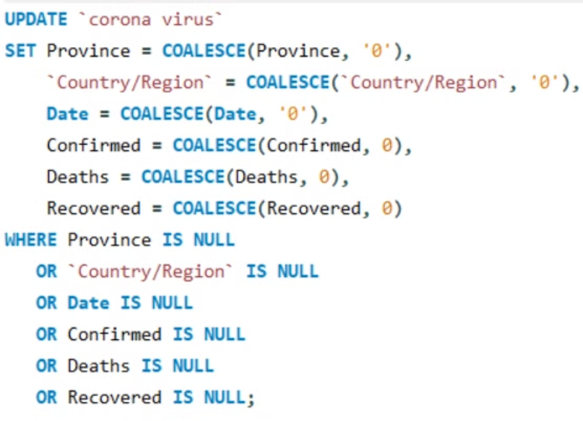
If NULL values are present, update them with zeros for all columns
Data Transformation
The data is formatted and transformed for analysis, ensuring variables are suitable for analysis.

Slide 7
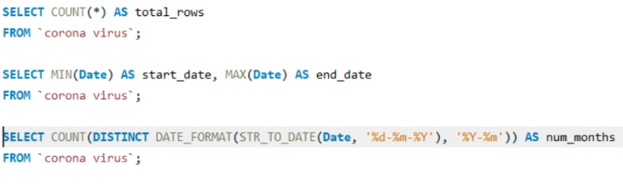
This query is for:
Check total number of rows.
Check what is start_date and end_date
Number of month present in dataset

Slide 8
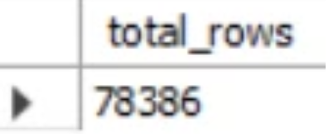
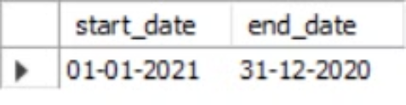
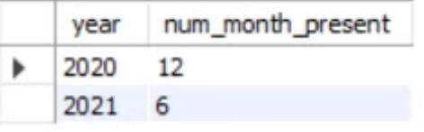
Outputs:
The dataset spans from 01/01/21 to 31/12/20.
In this dataset, there are 78,386 rows.
The total number of months, including 2020 and 2021, is 18. For 2020, there are 12 months, and for 2021, there are 6 months.

Slide 9
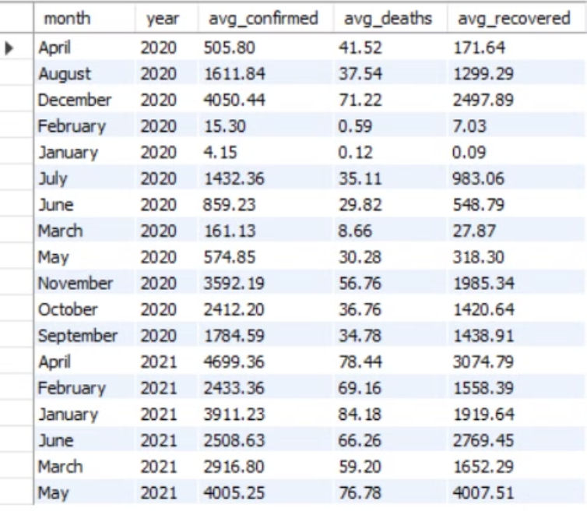
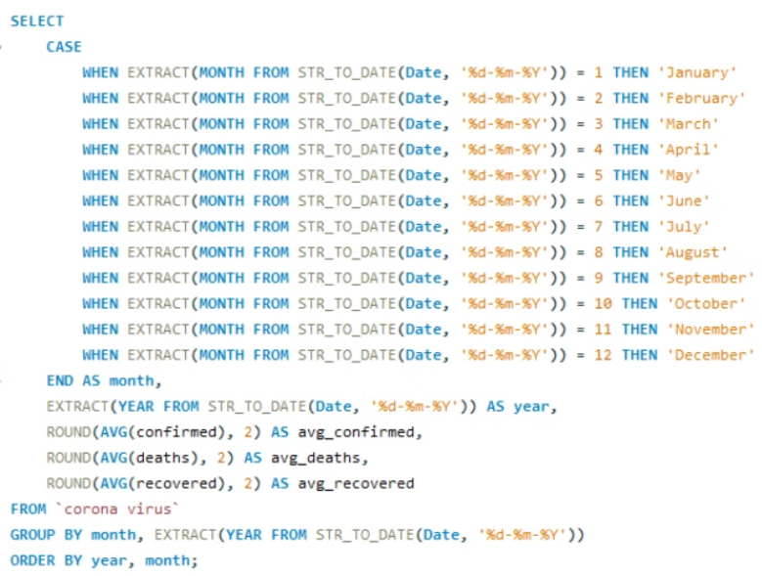
This below query is for find monthly average for confirmed, deaths, recovered
Output:

Slide 10
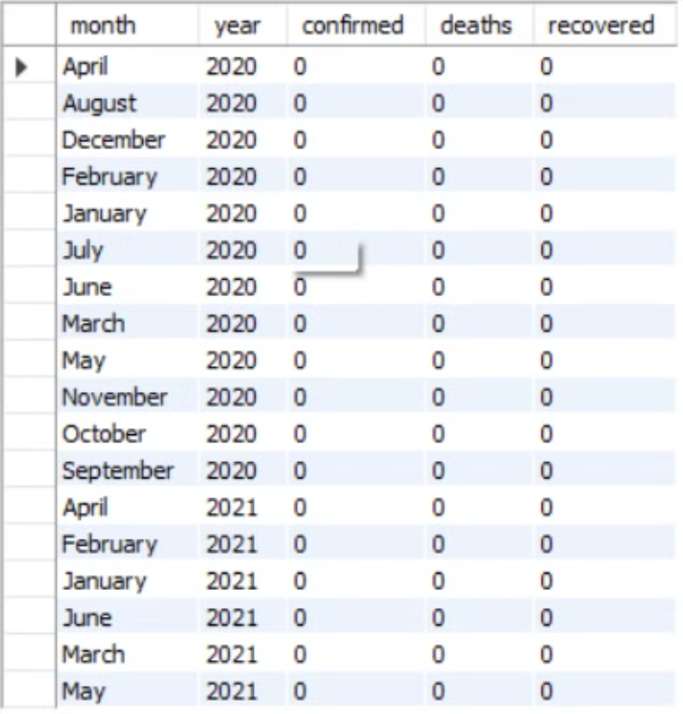
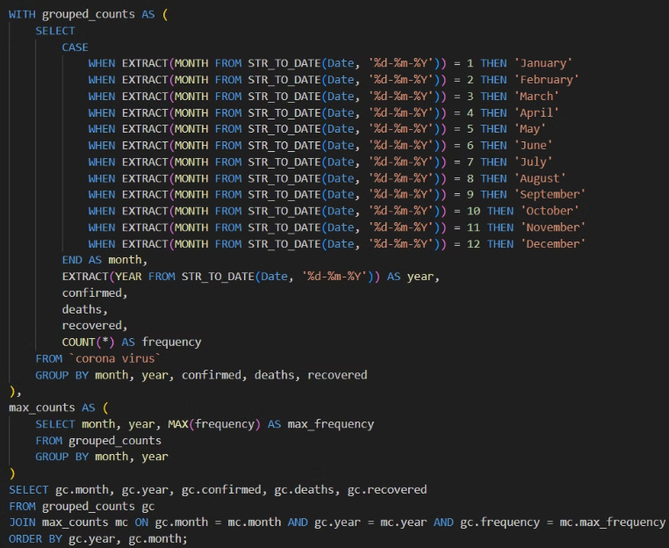
Output: The most frequent value used is 0.
This below query is for find most frequent value for confirmed, deaths, recovered each month

Slide 11
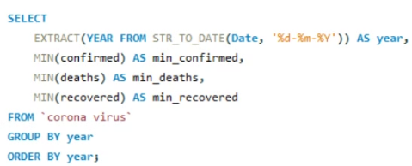
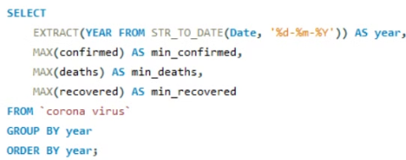
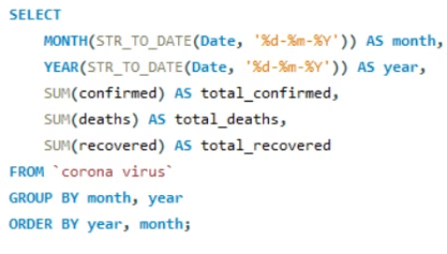
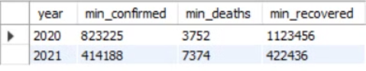
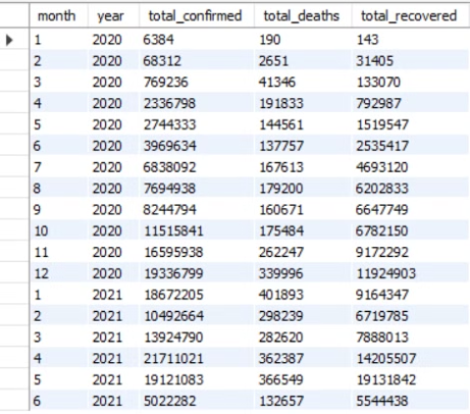
Minimum values for confirmed, deaths, recovered per year
Maximum values of confirmed, deaths, recovered per year
The total number of case of confirmed, deaths, recovered each month.
Output: 0
Output:
Output:

Slide 12
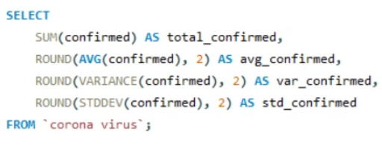
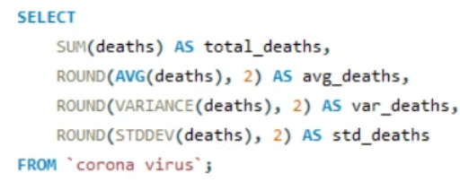
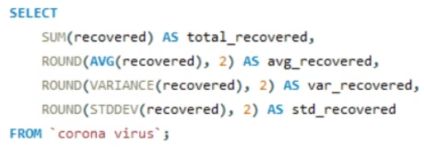
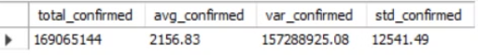
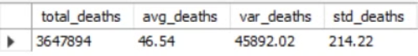
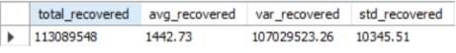
Virus spread out with respect to confirmed case (E.g. total confirmed cases, their average, variance & STDEV )
Corona virus spread out with respect to death case per month (E.g.. total deaths cases, their average, variance & STDEV )
Corona virus spread out with respect to recovered case (E.g. total recovered cases, their average, variance & STDEV )
Output:
Output:
Output:

Slide 13
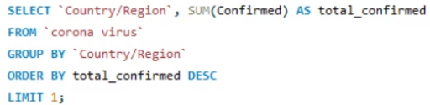
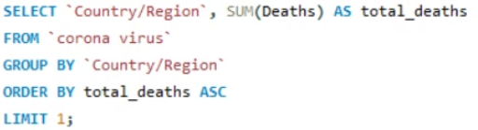
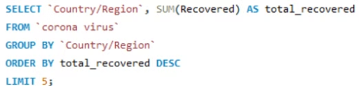
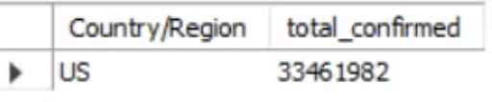
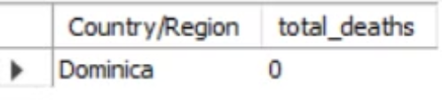
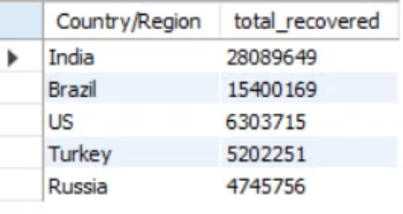
For Country having highest number of the Confirmed case
For Country having lowest number of the death case
Top 5 countries having highest recovered case
Output:
Output:
Output:

Slide 14

Conclusion: Key Insights from COVID-19 Data Analysis
The COVID-19 data analysis has revealed several key insights:
The virus had a significant impact on confirmed cases, deaths, and recoveries, with clear monthly trends and variations across countries.
The country with the highest confirmed cases had a concerning spike, while the country with the lowest death rate fared better.
Top countries with the highest recoveries demonstrated effective response and treatment efforts.

